Slide 1

SDG 6 Analytical Dashboard
By: Aqsa Shoeb,
Data Science Trainee, Scifor

Slide 2
1
Introduction
Data visualization is the art and science of representing complex information visually, making it more accessible, understandable, and actionable.
In a world inundated with vast amounts of data, data visualization serves as a powerful tool to uncover patterns, trends, and insights that might otherwise remain hidden in raw datasets.
Slide 1

Slide 3
1
Introduction
This project involves data cleaning processes followed by designing interactive dashboards through reactive programming
Python's versatility and simplicity make it a powerful language for data science. With libraries like Pandas, Python streamlines data manipulation and analysis tasks, offering a rich set of functions for efficient data handling, transformation, and exploration.
Slide 2

Slide 4
1
Introduction
Dash, a Python web framework, seamlessly integrates with Plotly to empower developers in creating interactive and customizable web applications for data visualization.
Sustainable Development Goal 6 (SDG 6) is a global initiative established by the United Nations to ensure the availability and sustainable management of water and sanitation for all. The goal aims to eradicate open defecation, improve water quality, and enhance water-use efficiency worldwide.
Slide 3

Slide 5
2
Objective
Core Objectives: Delivering a Robust and
User-Friendly Platform for Technical Exploration specifically about progress of different Countries
Focusing on only useful data through data cleaning techniques and organisation
Target Audience: Policymakers, Researchers, Stakeholders
Slide 4

Slide 6
2
Objective
Significance: Achieving SDG 6.2 Targets through understanding the progress of different countries.
Especially, In terms percentages of their population exposure to safe and healthy sanitation and water management practices.
Slide 5

Slide 7
3
Dataset
Dataset info: This dataset has been taken from the official website of World Health Organisation, WHO.
Format: The dataset was exported in the form of CSV files.
Source: WHO 6.1/6.2/6.a
Slide 6

Slide 8
3
Dataset
Includes the following CSV files:
Population using safely managed sanitation services (%)
Population using safely managed water drinking services (%)
Population having basic handwashing facilities in home (%)
Slide 7

Slide 9
4
Techstack
Python 3.11.5: Backend language
Dash 2.8.1: Web App Framework
Plotly Express 0.4.0: Visualisation
Pandas 2.1.4: Data cleaning and manipulation
Slide 8

Slide 10
4
Environment
Data cleaning Environment
Google Colaboratory
Development Environment
Python Virtual Environment
Code editor: VS Code
Slide 9

Slide 11
5
Data Cleaning Steps
Dropping empty column
Dropping columns that are not required or are noise columns
Formatting values where necessary
Renaming column labels to make them more meaningful
Sorting
Slide 10

Slide 12
6
Basic Steps involved
Loading the respective CSV file
Creating interactive dropdown menu
Creating the required graphs and data visualisation
Programming callbacks to make dropdown menu and graphs interactive
Slide 11

Slide 13
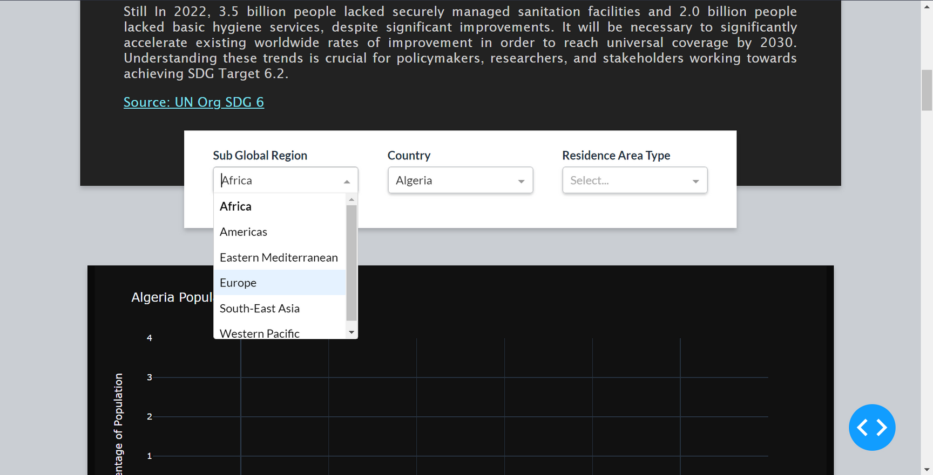
7
Output
Slide 12

Slide 14
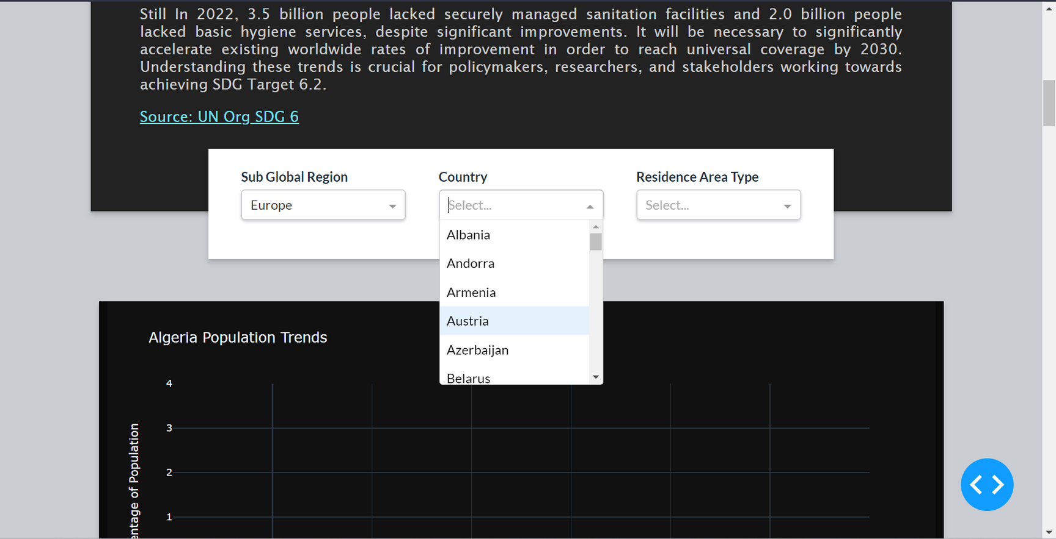
7
Output
Slide 13

Slide 15
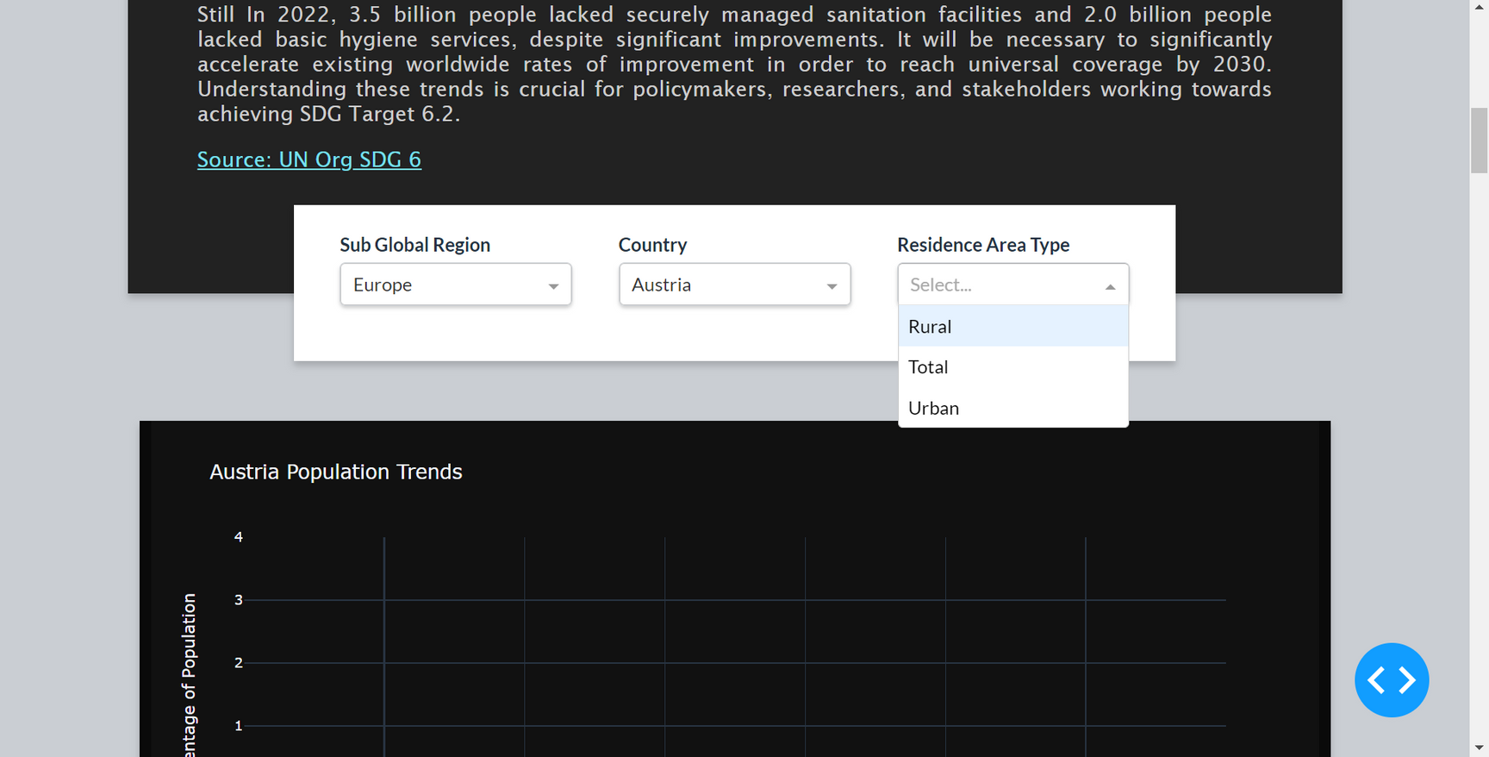
7
Output
Slide 14

Slide 16
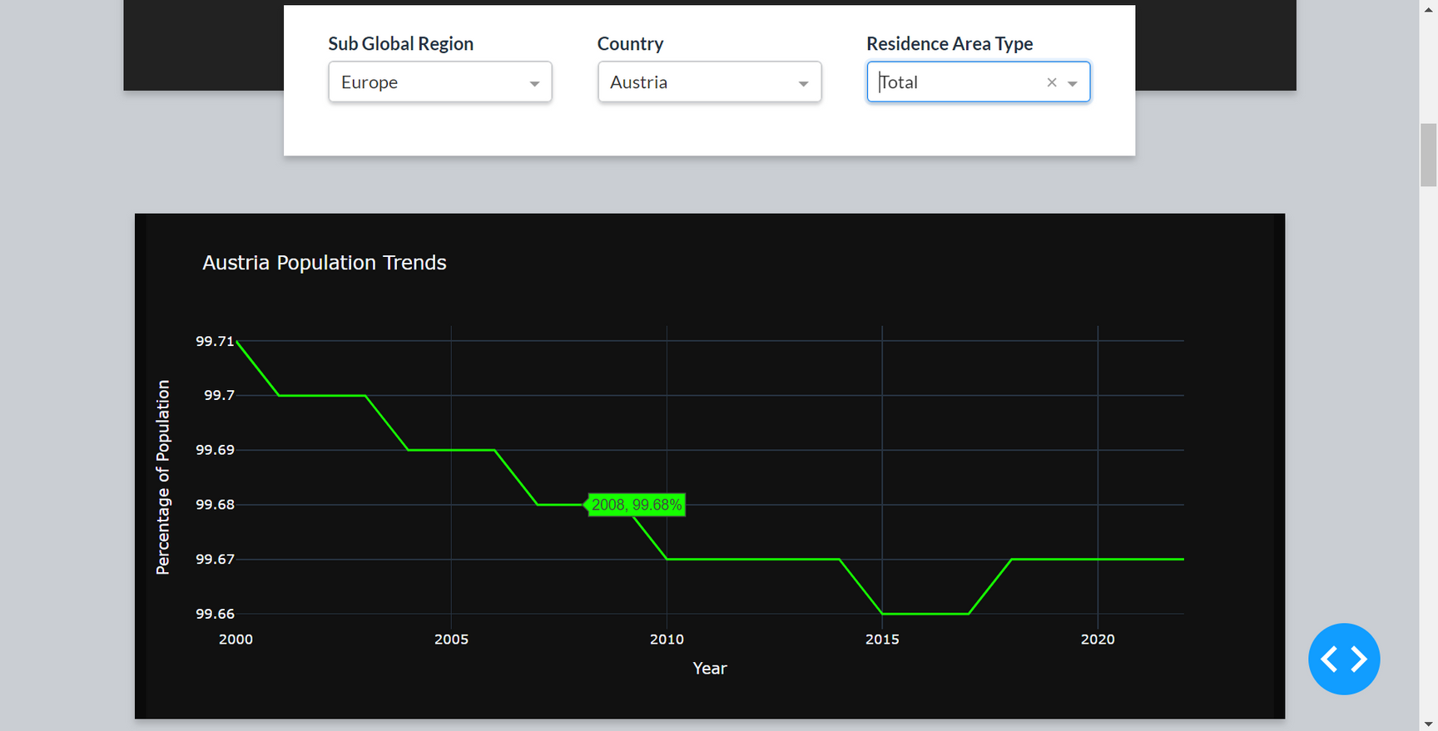
7
Output
Slide 15

Slide 17
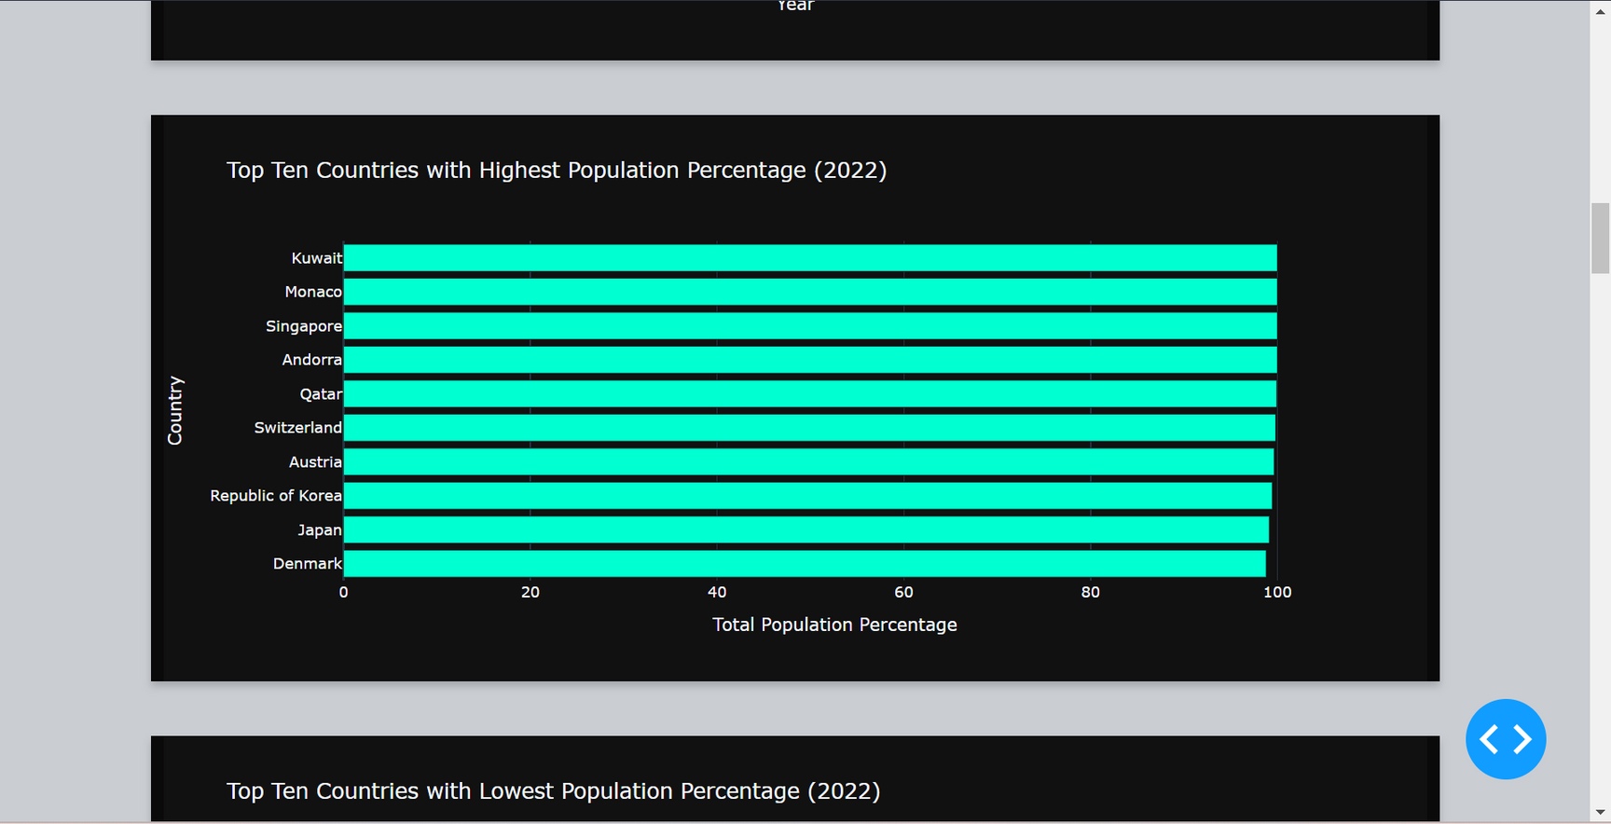
7
Output
Slide 16

Slide 18
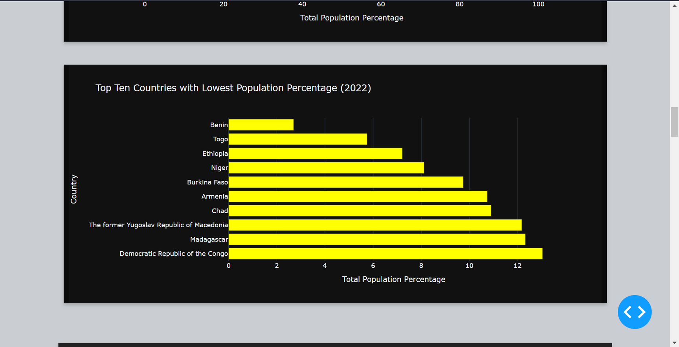
7
Output
Slide 17

Slide 19
8
Conclusion
Through python libraries and frameworks such as Pandas, Dash and Plotly
We can easily clean and manage data files such as CSVs as well as create interactive dashboards with user-friendly GUI.
Studying data visually is more productive and easy for analysts and researchers
Slide 18

Slide 20
Special thanks to the Dash and Plotly communities for providing robust tools that empower us to visualize and share insights, fostering collaboration and progress.
We hope this was worthwhile for you
Thank You!!

